Slide 2
How You Can be a CivicPlus® Brand Ambassador and Social Media Influencer

Slide 3
👋 New Team
Follow CivicPlus on Social Media
Facebook | facebook.com/CivicPlus
Twitter | @civicplus
LinkedIn | linkedin.com/company/civicplus/

Slide 4
Pre-Optimere Acquisition
550
Employees
2,894
Followers
2,416
Facebook Likes
6,285
LinkedIn Followers
Potential Company Reach
11,595
Potential Employee
Influencers Reach Reach
649,000

Slide 5
Pre-Optimere Acquisition
900
Employees
2,894
Followers
2,416
Facebook Likes
6,285
LinkedIn Followers
Potential Company Reach
11,595
Potential Employee
Influencers Reach Reach
1,062,000

Slide 6
Let’s Collab
Engage daily with our content
Like
Share
Comment
Re-post and Re-Tweet

Slide 7
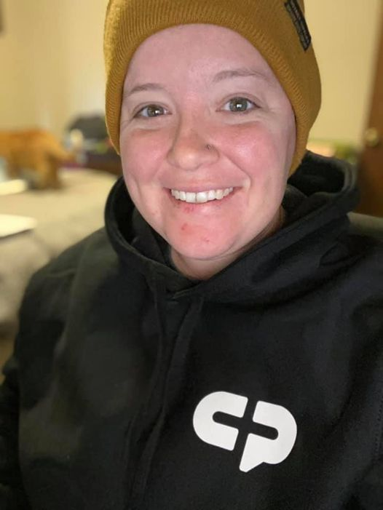
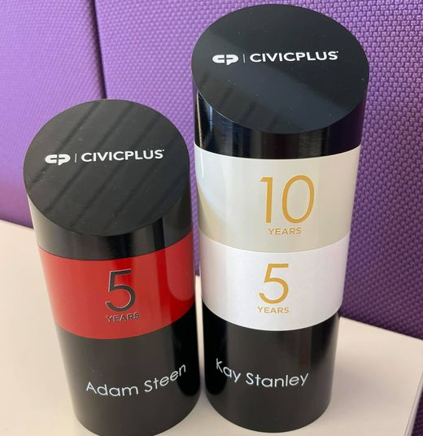
Tag @CivicPlus
Share customer meetings
Zoom training sessions
Team happy hours
You and your CP Swag
Work-from-home life

Slide 8
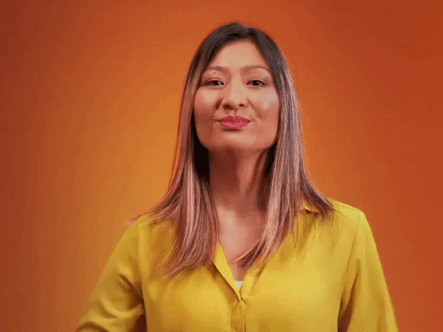
Use Company and Industry Hashtags
#CPfamily
#weareparksandrec
#govtech
#civicexpereience

Slide 9
Expand Your Professional Network
Connect with customers and prospects on LinkedIn, no matter your role or department

Slide 10
We’re Not the Lawyers But…
Please follow our Social Media Guidelines

Slide 11
Social Media Guidelines
Do not discuss company confidential or proprietary information on social media
Before you post, ask yourself if your message adheres to our core values
Do not sure anyone’s likeness without their permission, especially minors
Be respectful and adhere to our values of diversity, equity, inclusion, and belonging
Follow copyright laws related to the use of imagery, music, photos, videos, and graphics
Do not state your opinion on behalf of CivicPlus
Use only marketing approved logos or company graphics
Allow social administrators to respond to negative comments or reviews

Slide 12
Thank You
#follow #f4f #followme #followforfollow #follow4follow #teamfollowback #followher #followbackteam #followhim #followalways #followback #pleasefollow #follows #follower #following

